Slide 1
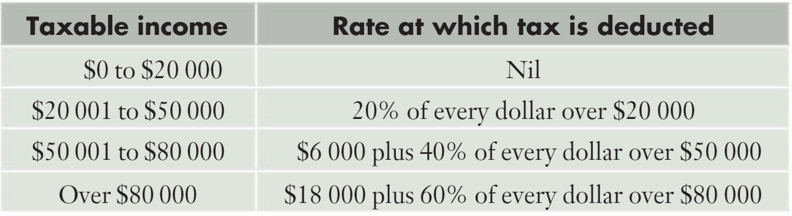
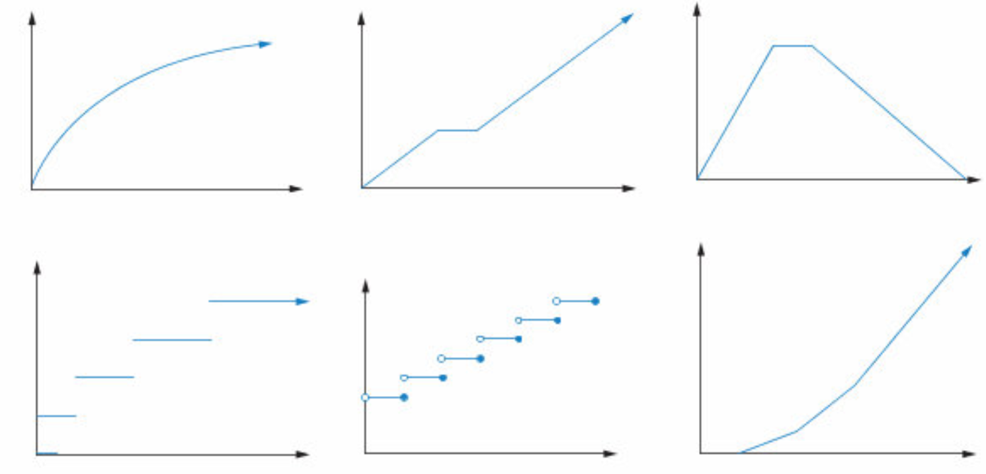
Example 2
The income tax system in Australia is what is known as a ‘progressive system’. This means that the rate of income tax increases as a person’s taxable income increases.
For this situation suppose that the following progressive system were to apply:
Which graph best displays this situation?

Slide 2
Example 2
To deliver a parcel from Town A to Town B a company charges $7.50 for the first kilogram, or part thereof, and then a further $2.50 per kilogram, or part thereof, after that. Thus a parcel weighing 0.56kg will cost $7.50, a parcel weighing 2.4 kilograms will cost $12.50, a parcel weighing 5.1 kilograms will cost $20:
Which graph best displays this situation?

Slide 3
Example 2
John has bought a new racing bike and has sold his old one to Peter. Peter lives 12 kilometres from John’s house, along an almost straight road. John rides the bike to Peter’s house, stays there for 30 minutes having a chat with peter, and then walks back to his own home. He cycles at a steady 12km per hour and walks at a steady 6km per hour.
Which graph best displays this situation?

Slide 4
Example 2
For all the relationships we discussed previously it involved linear relationships but changed depending on where we were on the x axis. We call this type of relationship a piecewise relationship.
Which graph are also called step graphs?
Which graph is not an example of a piecewise relationship?

Slide 5
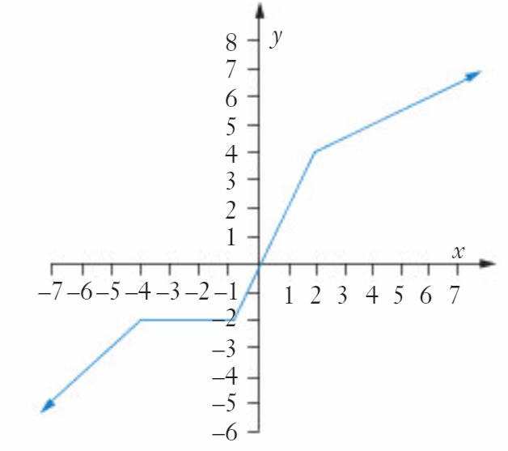
Example 2
For the equation below:
There is one rule for x less than -4, another for x between -4 and -1, etc.
We write this as below:
$$For x<−4, y=x+2$$
$$For −4≤x<−1, y=−2$$
$$For −1≤x<2, y=2x$$
$$For x≥2, y=0.5x+3$$

Slide 6
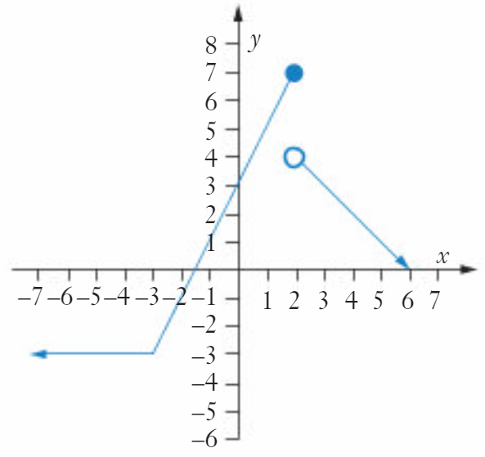
Example 2
Closed dot means equal to
$$For x<−3, y=−3$$
Open dot means not equal to
$$For −3≤x≤2, y=2x+3$$
$$For x>2, y=−x+6$$

